Slide 1
Design and Analysis of Algorithms
CS345A
Lecture 1
Overview of the course
Closest Pair problem

Slide 2
Some Information CS345: Algorithms II
Instructor email: rtewari@cse.iitk.ac.in
TA in-charge: Ronak Bhadra (ronakb@cse.iitk.ac.in)
Course Website: moodle.cse.iitk.ac.in

Slide 3
Acknowledgment
Thanks to Prof Surender Baswana for allowing me to use and modify his lecture slides.

Slide 4
Aim of the course
To empower each student with the skills to design algorithms
With provable guarantee on correctness.
With provable guarantee on their efficiency.

Slide 5
Algorithm Paradigm
Motivation:
Many problems whose algorithms are based on a common approach.
➔ A need of a systematic study of the characteristics of such approaches.
Algorithm Paradigms:
Divide and Conquer
Greedy Strategy
Dynamic Programming
(advanced)
(advanced)

Slide 6



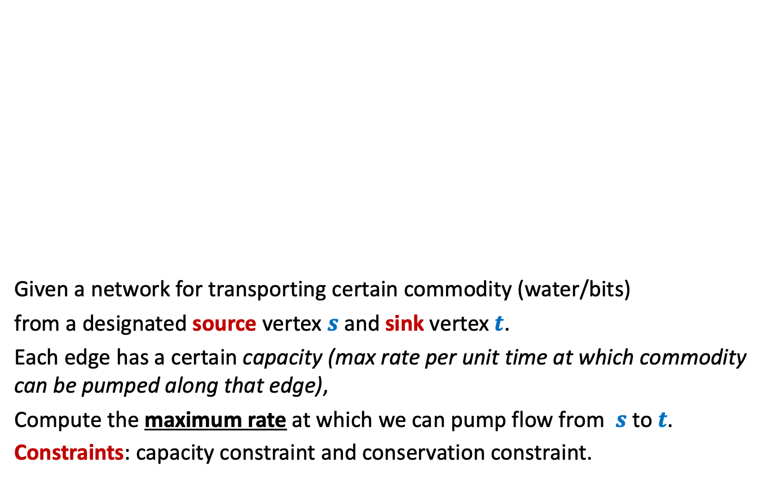



Maximum Flow
2
Given a network for transporting certain commodity (water/bits)
from a designated source vertex $s$and sink vertex $t$.
Each edge has a certain capacity (max rate per unit time at which commodity can be pumped along that edge),
Compute the maximum rate at which we can pump flow from $s$to $t$.
Constraints: capacity constraint and conservation constraint.
$$v$$
$$x$$
5
16
15
8
$$t$$
$$s$$
6
17
14
7
17
$$u$$
4
$$y$$

Slide 7
Miscellaneous
More applications of DFS
Matching in Graphs
Maximum matching, Stable matching
Amortized Analysis
A powerful technique to analyze time complexity of algorithms
String Matching
Finding Median using Small Space

Slide 8
Last topic on Algorithms
NP Complete problems
Approximation/randomized Algorithms

Slide 9
Data structures
Augmented Binary Search Trees
Range Minima Data structure (optimal size)
Fibonacci Heap
: Additional information

Slide 10

Orthogonal Range searching
A novel application of augmented BST
Exercise Problem: Preprocess a set of $n$ points so that given any query rectangle, the number of points lying inside it can be reported efficiently.
Data structure:
size = O($n log n$), Query = O($\log^{2} n$),
size = O($n$), Query = O($\sqrt{n}$),
Rectangle
Rectangle
Try to solve it…
You can surely do it…☺
We will do it soon

Slide 11
Divide and Conquer
A paradigm for Algorithm Design

Slide 12
An Overview
A problem in this paradigm is solved in the following way.
Divide the problem instance into two or more instances of the same problem.
Solve each smaller instance recursively (base case suitably defined).
Combine the solutions of the smaller instances
to get the solution of the original instance.
This is usually the main nontrivial step in the design of an algorithm using divide and conquer strategy

Slide 13

Example Problems
Merge Sort
Multiplication of two $n$-bit integers.
Counting the number of inversions in an array.
Median finding in linear time.

Slide 14
problem 1
Closest Pair of Points

Slide 15

The Closest Pair Problem
$$δ$$

Slide 16
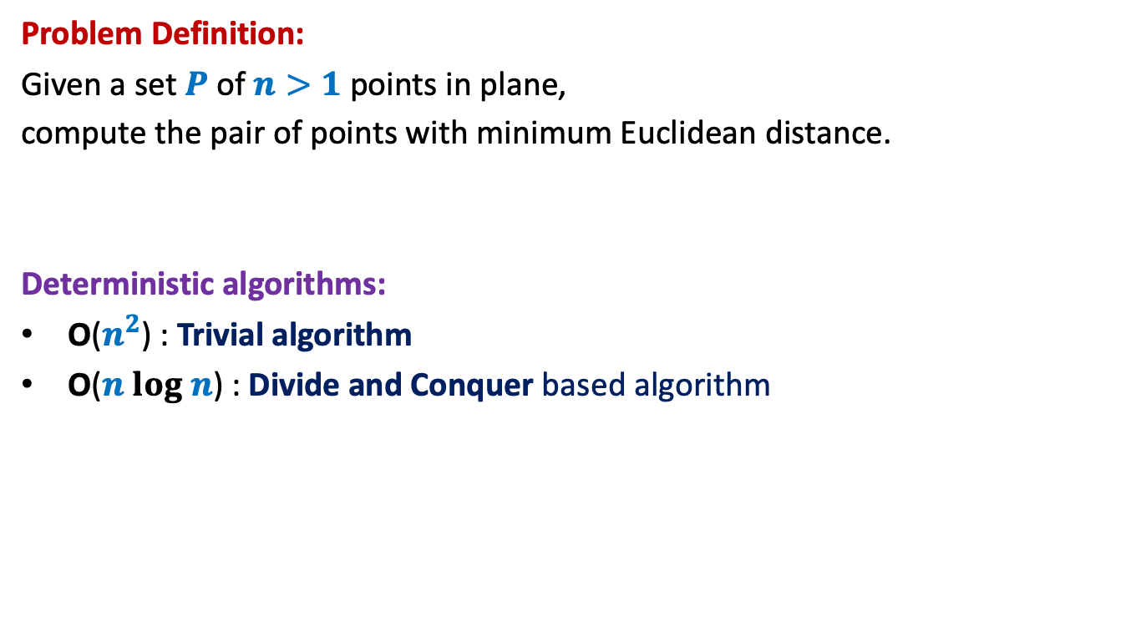
Closest Pair of Points
Problem Definition:
Given a set $P$of $n>1$points in plane,
compute the pair of points with minimum Euclidean distance.
Deterministic algorithms:
O($n^{2}$) : Trivial algorithm
O($n log n$) : Divide and Conquer based algorithm

Slide 17

Hint/Tool No. 1
A discrete math exercise
Exercise:
What is the maximum number of points that can be placed in a unit square
such that the minimum distance is at least 1 ?
Answer: 4.
If there are more than 4 points, at least one of the four small squares will have more than 1 points.
$$\frac{1}{\sqrt{2}}$$
1

Slide 18
Hint/Tool No. 2
When do we use a data structure ?
Question:
For which algorithmic problems do we need a suitable data structure ?
Answer:
If the problem involves “many” operations of same type on a given data.
For example, it is worth sorting an array only if there are going to be many search queries on it.
Let us see if you can use this principle in today’s class itself ☺

Slide 19

The divide step
$\frac{n}{2}$points
$\frac{n}{2}$points

Slide 20



The conquer step
Compute closest pair of the left half set
Compute closest pair of the right half set
$$δ_{L}$$
$$δ_{R}$$
Notice $δ_{L}$ ${<δ}_{R}$ for this given instance

Slide 21


The combine step
Which points do we need to focus on for the closest pairs ?
$$δ_{L}$$
$$δ_{R}$$
$$δ_{L}$$
$$δ_{L}$$

Slide 22
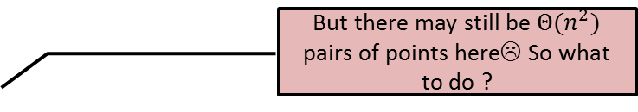

The combine step
But there may still be $Θ(n^{2})$ pairs of points here☹ So what to do ?
$$δ_{L}$$
$$δ_{R}$$
$$δ_{L}$$
$$δ_{L}$$

Slide 23

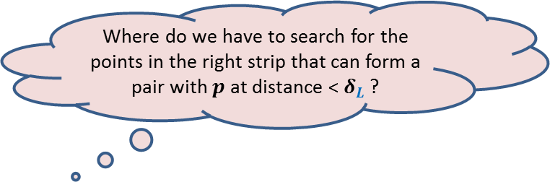
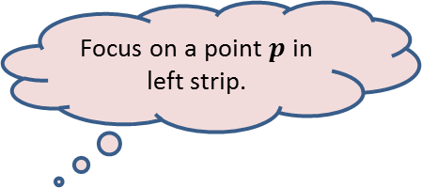
The combine step
Focus on a point $p$in left strip.
Where do we have to search for the points in the right strip that can form a pair with $p$ at distance < $δ_{L}$ ?
$$δ_{L}$$
$$p$$
$$δ_{R}$$
$$δ_{L}$$
$$δ_{L}$$

Slide 24

The combine step
$$δ_{L}$$
$$δ_{L}$$
$$p$$
$$δ_{L}$$
$$δ_{R}$$
$$δ_{L}$$
$$δ_{L}$$

Slide 25
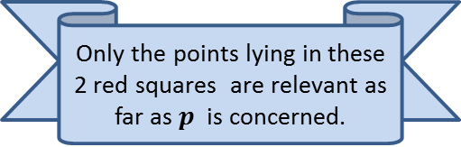

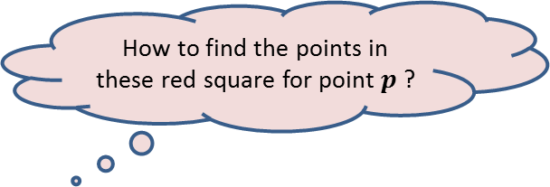
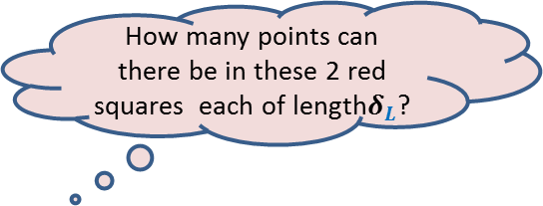
The combine step
How many points can there be in these 2 red squares each of length$δ_{L}$?
Only the points lying in these 2 red squares are relevant as far as $p$ is concerned.
How to find the points in these red square for point $p$?
$$δ_{L}$$
It will take $O(n)$time for a given $p$.
Surely not more than 8
(using Hint 1)
$$δ_{L}$$
$$p$$
$$δ_{L}$$
$$δ_{R}$$
$$δ_{L}$$
It is time to use Hint/Tool no. 2.
$$δ_{L}$$

Slide 26

The combine step
$$δ_{L}$$
$$δ_{L}$$
An array storing the points of the right strip in increasing order of y-coordinates.
$$δ_{L}$$
We need to find points in the 2 red square for every point in the left strip.
What will be
the data structure ?
$$δ_{L}$$
$$δ_{L}$$
$$δ_{L}$$
So build a suitable data structure
for points in the right strip so that
we can answer such query efficiently
for each point in the left strip.
$$δ_{L}$$
$$δ_{R}$$
$$δ_{L}$$
$$δ_{L}$$

Slide 27

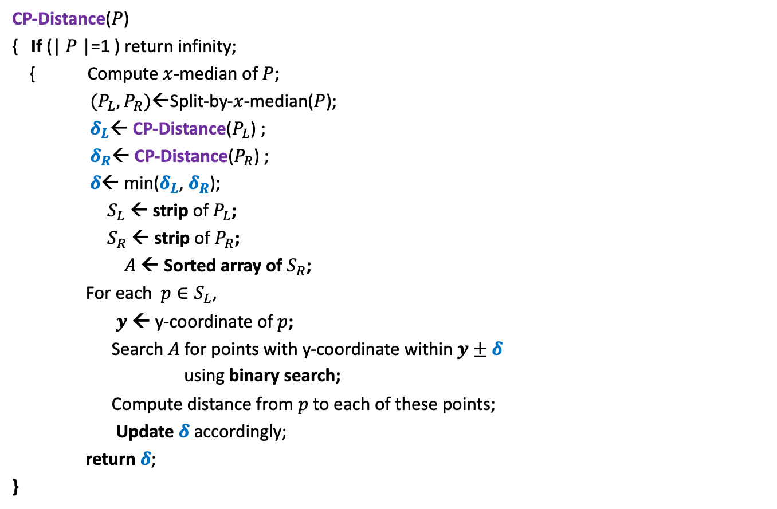

Divide and Conquer based algorithm
CP-Distance($P$)
{ If (| $P$|=1 ) return infinity;
{ Compute $x$-median of $P$;
$(P_{L},P_{R})$←Split-by-$x$-median($P$);
$δ_{L}$← CP-Distance($P_{L}$) ;
$δ_{R}$← CP-Distance($P_{R}$) ;
$δ$← min($δ_{L}$, $δ_{R}$);
$S_{L}$ ← strip of $P_{L}$;
$S_{R}$ ← strip of $P_{R}$;
$A$← Sorted array of $S_{R}$;
For each $p∈S_{L}$,
$y$ ← y-coordinate of $p$;
Search $A$for points with y-coordinate within $y±δ$
using binary search;
Compute distance from $p$to each of these points;
Update $δ$ accordingly;
return $δ$;
}
$O(\left|P\right|)$ + 2 T(|$P$|/2) time
Divide step
$O(\left|P\right| \log{P})$ time
Combine/conquer step

Slide 28
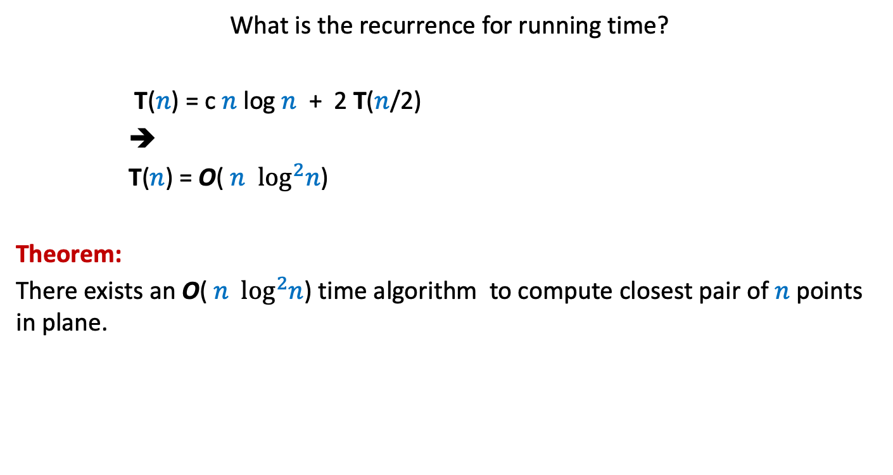
Running time of the algorithm
What is the recurrence for running time?
T($n$) = c $n$ log $n$ + 2 T($n$/2)
➔
T($n$) = O( $n$ $\log^{2}n$)
Theorem:
There exists an O( $n$ $\log^{2}n$) time algorithm to compute closest pair of $n$points in plane.

Slide 29

Conclusion
Homework:
Try to improve the running time to O( $n\log{n}$).
Hint: “the code will look similar to that of MergeSort”.
2. Ponder over the data structure for orthogonal range searching.

